Slide 1
How does the web works?
What’s web?
Web is part of internet, is built from several technologies which, when combined together like:
HTML (HyperText Markup Language )
CSS (Cascading Style Sheets)
JAVASCRIPT

Slide 2
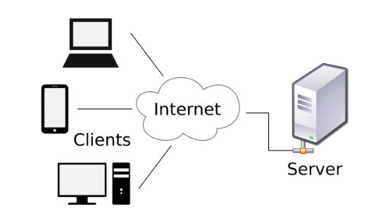
How does the web works?
How does work?
Uses HTTP Protocol to transmit data .
Notes:
Clients can be: browsers, mobile applications, TVs…Etc.
Servers are applications that run on a special compute

Slide 3
What do you need to be a web developer?
HTML
CSS
JAVASCRIPT
Design software: Photoshop and Illustrator and Sketch

Slide 4
What’s the role of a web developer?
Work on a new project (a new website) from scratch.
Work on an existing website and make it better.

